Slide 1
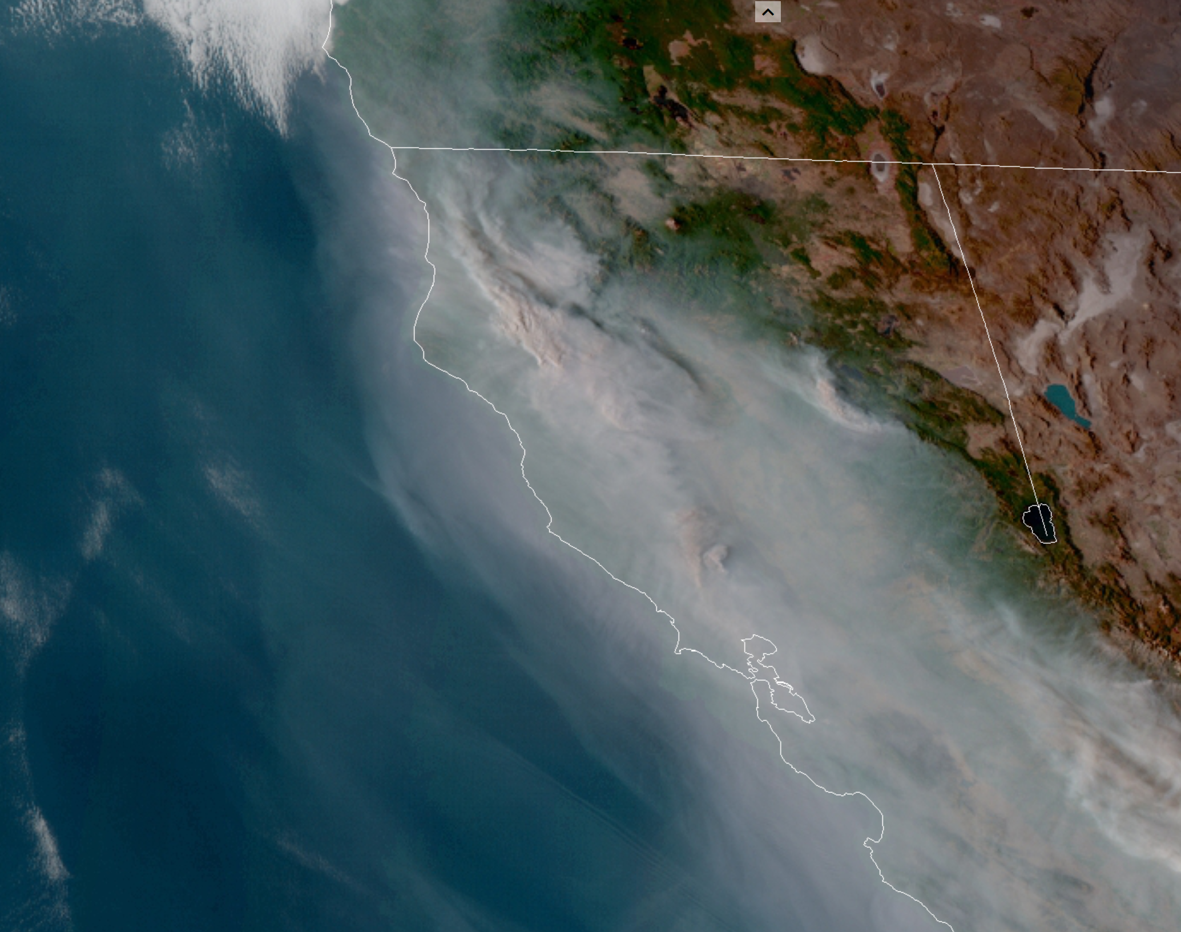
GOES FIRE AND SMOKE TOOL (GOFAST): 2020 Pilot

Slide 2
Take home points
Simple tool for looking quickly at fire progression and activity, based on the GOES IR sensor Fire Radiative Power product
Near realtime (fire detections from as recently as 30 minutes)
Also retrospective view at emissions (all you need is an estimated current fire size) going back days, months to see daily growth/emissions
Can be pulled directly into model runs for source apportionment with multiple overlapping plumes affecting a site, (e.g., Mueller et al., 2020; http://dx.doi.org/10.3390/atmos11090970 )
Like purple air for emissions
Good at relative, not necessarily absolute (we’re working on that paper), day to day trends
E.g., lot of night time activity, post-NIROPs
Useful for understanding the contribution of fire activity to forecasted and previous days AQI
Adds to situational awareness, especially for
Large fires (can miss acreages under 100 acres or heat obscured by clouds or thick smoke)
Remote deployment/pre-deployment
Area Command sitches where multiple interacting (even joining) fires create too much “perimeter spaghetti” to untangle

Slide 3
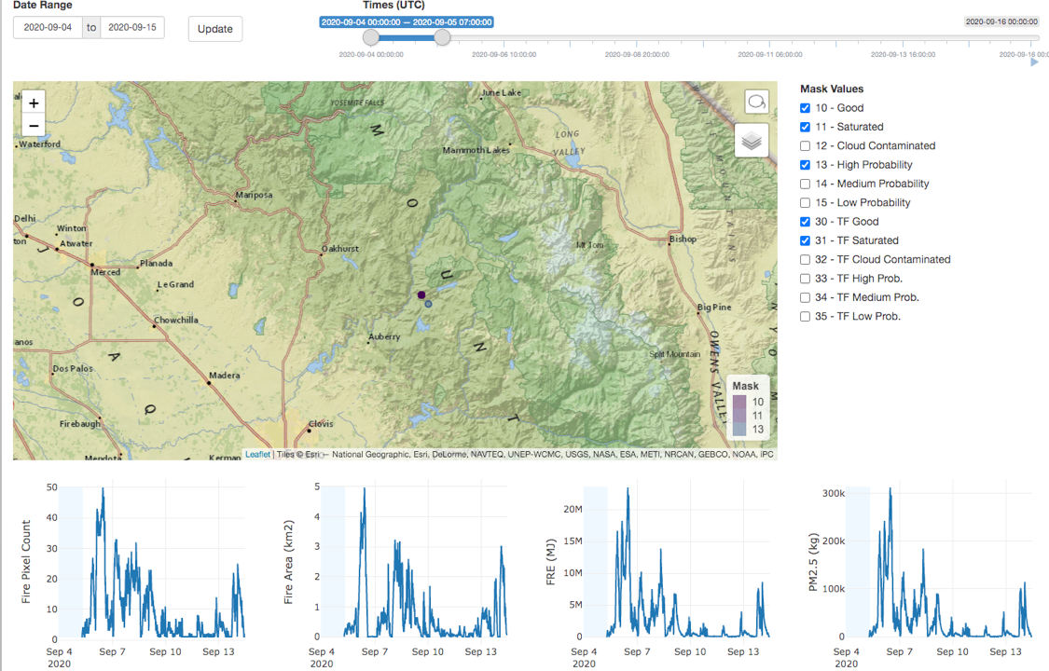
2020-09-04
Fire activity/Fire Growth

Slide 4
Multiple fires, Large area retrospective on relative daily emissions:

Slide 5
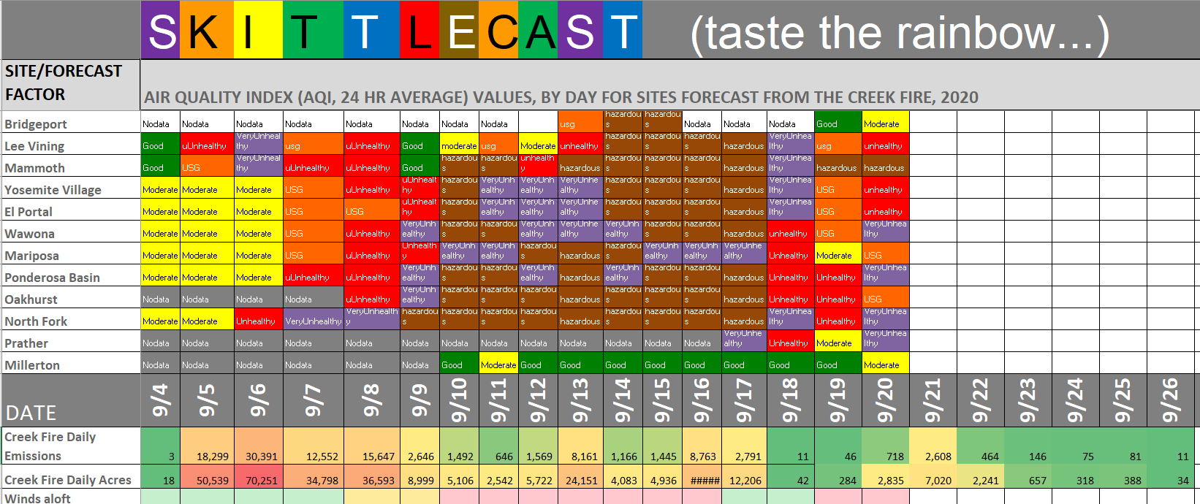
Day to day variation, as it compares to AQI

Slide 6
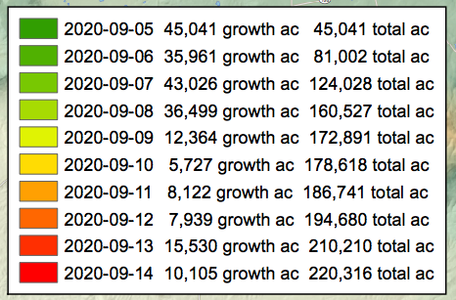
Creek Wildfire 9/4-15/2020 – Estimated Daily Acres & PM2.5 Emissions (short tons) Estimates Based on GOES-16 Satellite Data
Progression Map
https://ftp.nifc.gov/public/incident_specific_data/calif_s/!2020_Incidents/CA-SNF-001391_Creek/GIS/Products/20200916/prog_arch_e_land_20200916_2205_Creek_CASNF001391_0909.pdf

Slide 7
2020-09-04
Fire activity/Fire Growth

Slide 8
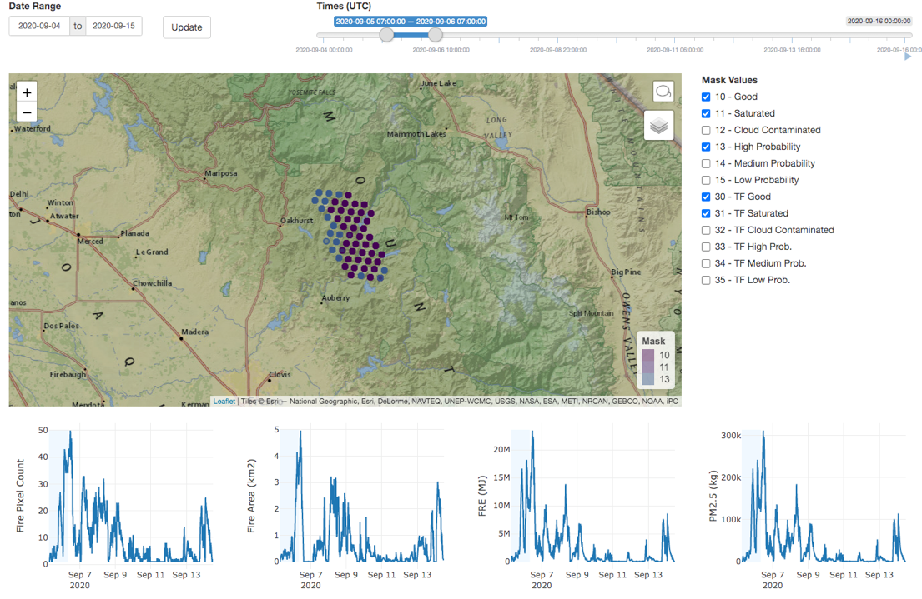
2020-09-05
Fire activity/Fire Growth

Slide 9
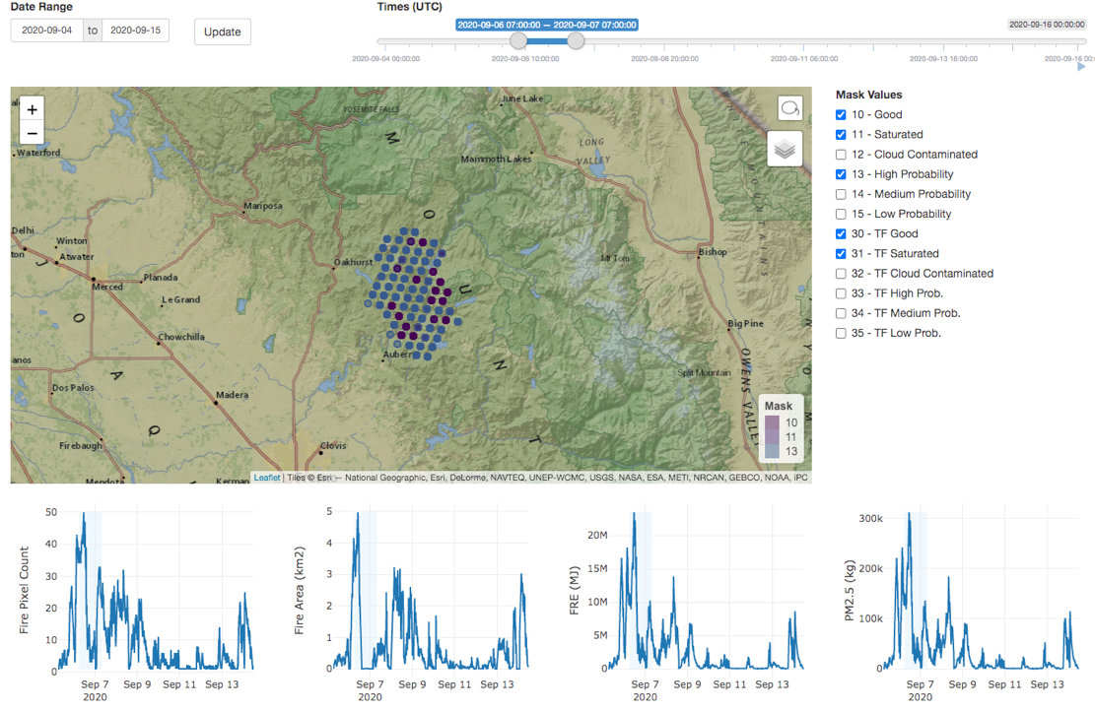
2020-09-06
Fire activity/Fire Growth

Slide 10
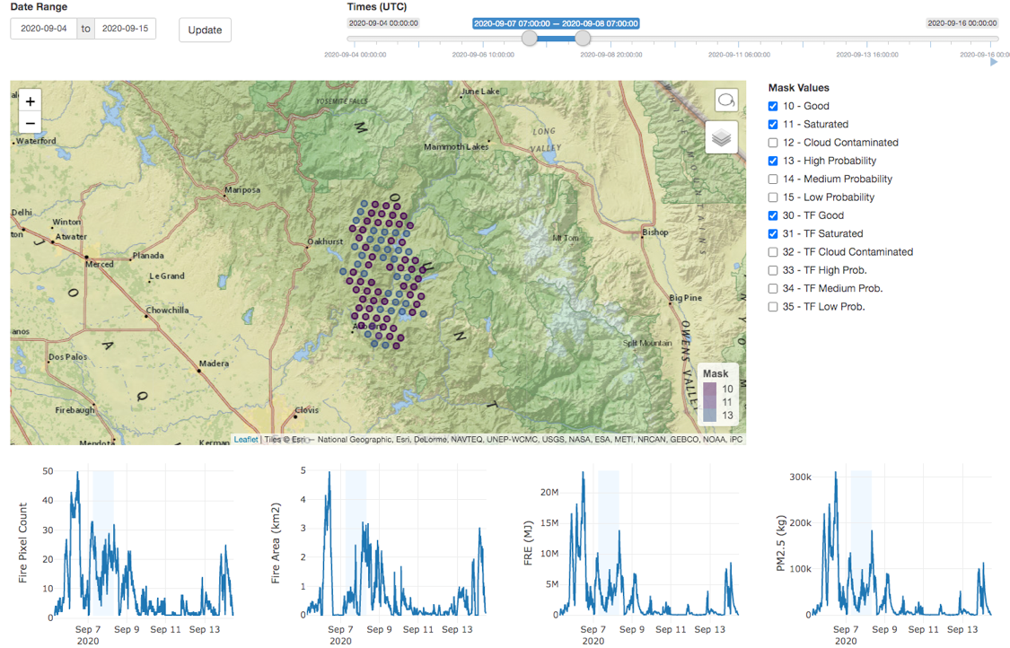
2020-09-07
Fire activity/Fire Growth

Slide 11
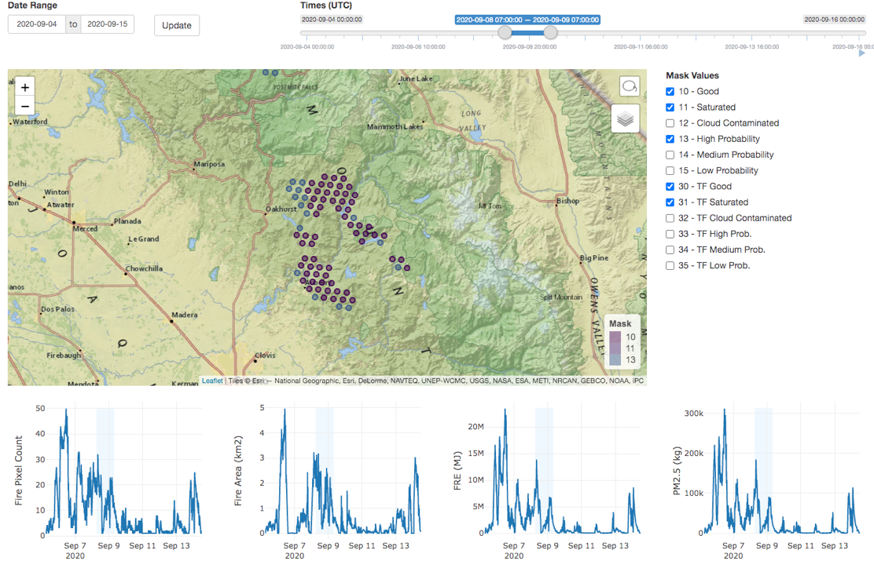
2020-09-08
Fire activity/Fire Growth

Slide 12
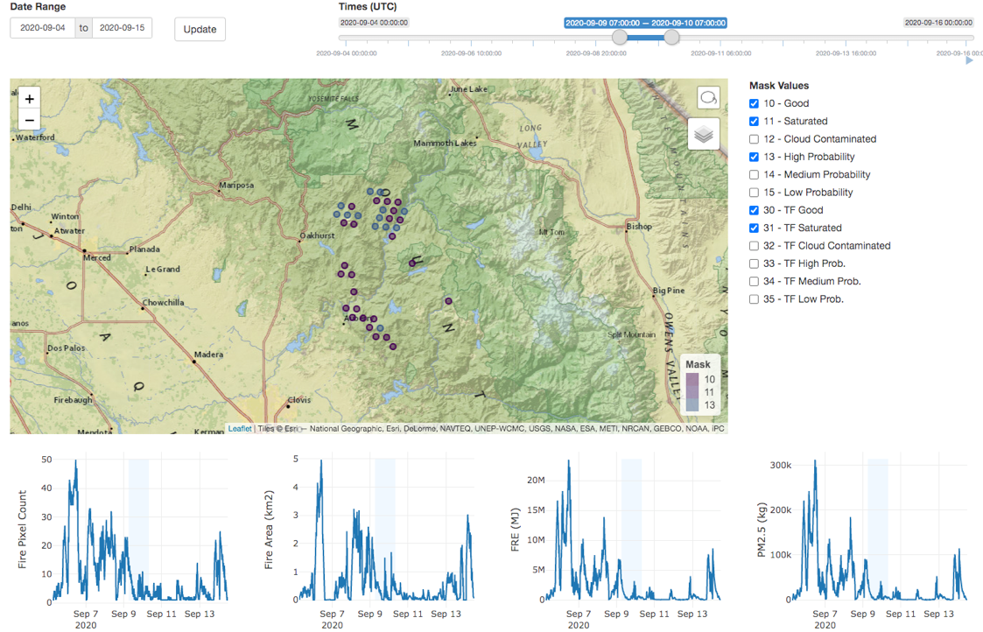
2020-09-09
Fire activity/Fire Growth

Slide 13
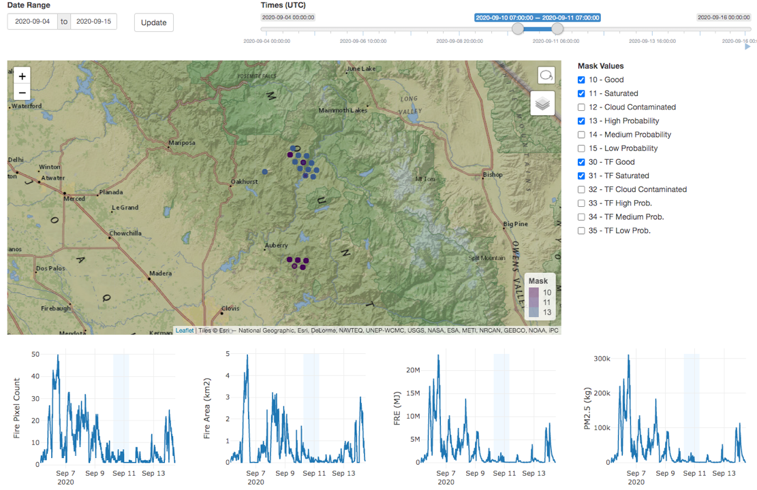
2020-09-10
Fire activity/Fire Growth

Slide 14
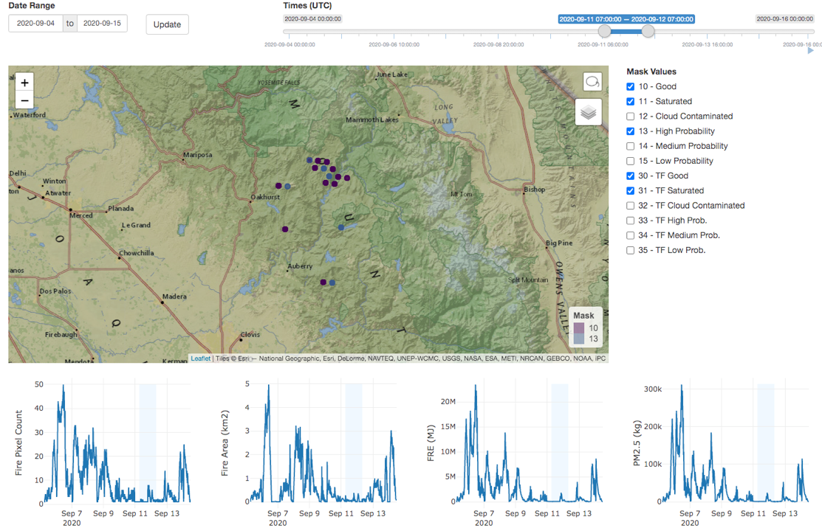
2020-09-11
Fire activity/Fire Growth

Slide 15
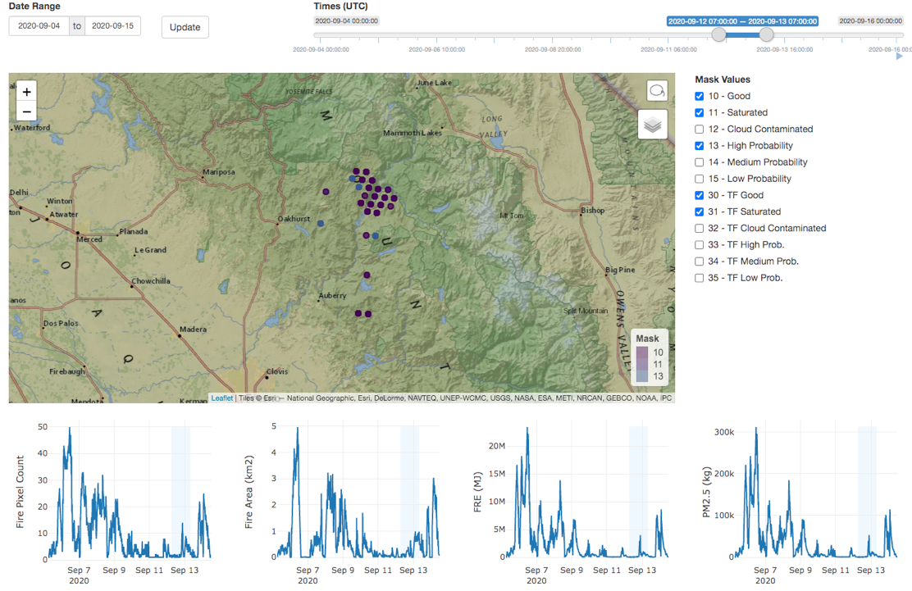
2020-09-12
Fire activity/Fire Growth

Slide 16
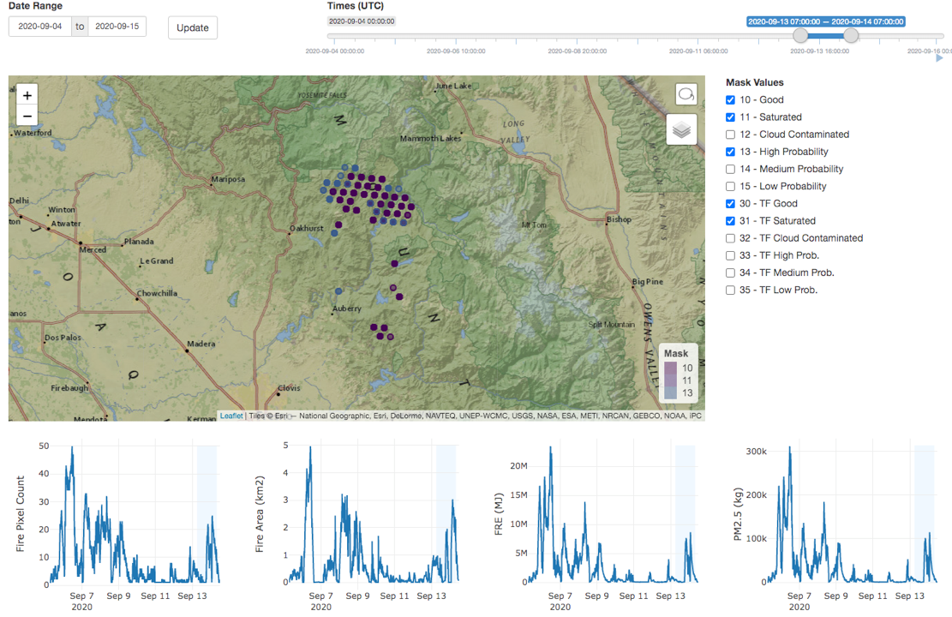
2020-09-13
Fire activity/Fire Growth

Slide 17
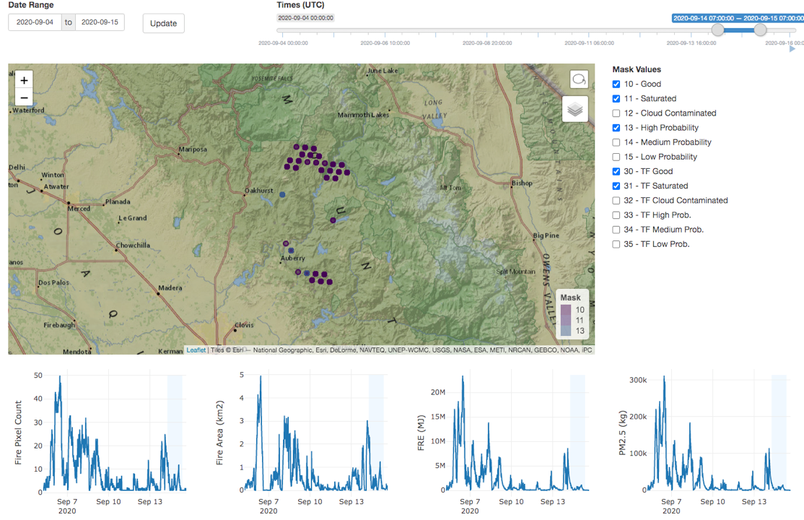
2020-09-14
Fire activity/Fire Growth

Slide 18
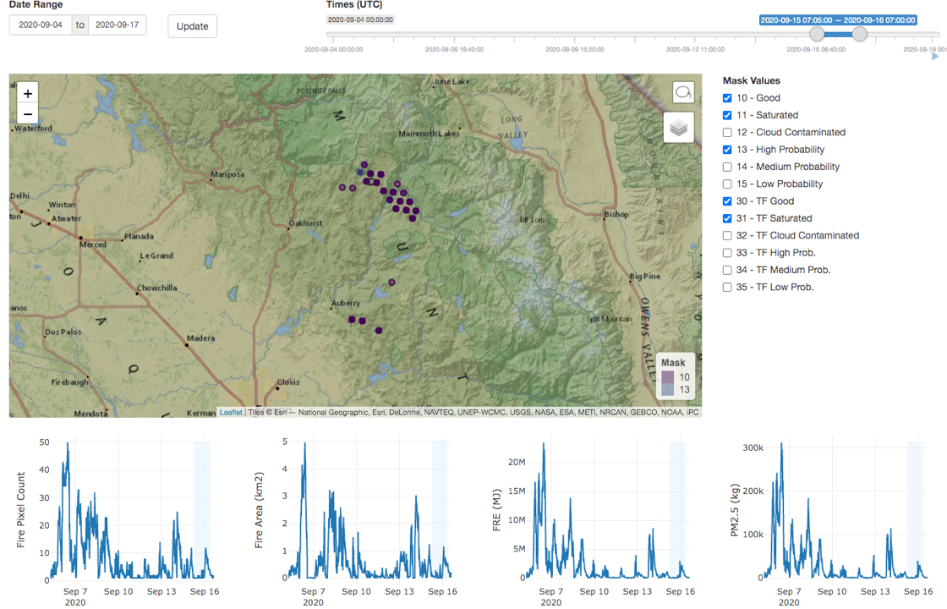
2020-09-15
Fire activity/Fire Growth

